Slide 1
PDCB BioC for HTS topic Understanding the tech. 01
LCG Leonardo Collado Torres
lcollado@wintergenomic.com lcollado@ibt.unam.mx
August 25th, 2010

Slide 2
Topics
Next generation sequencing technologies
454
SOLiD
Pacific Biosciences
Illumina
Paired-end and Mate-pair
Ion Torrent

Slide 3
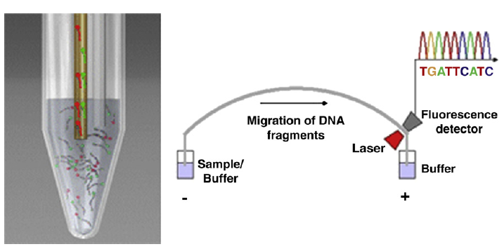
NGS tech

Slide 4
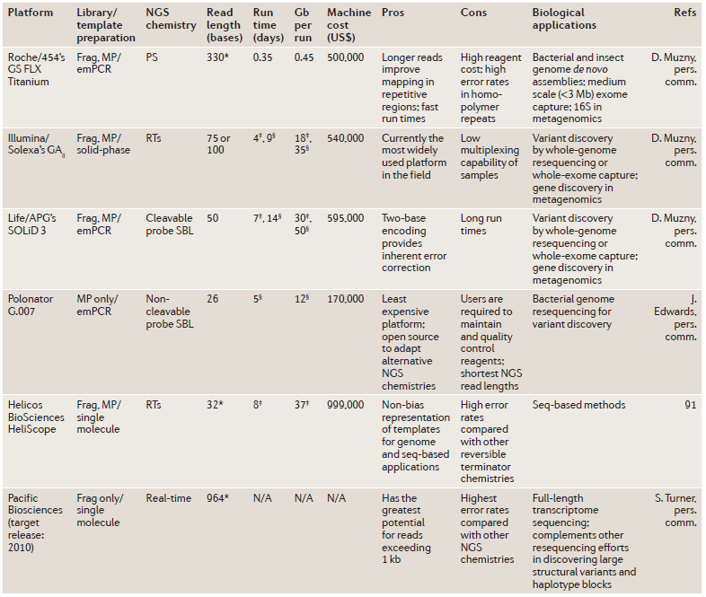
NGS tech

Slide 5
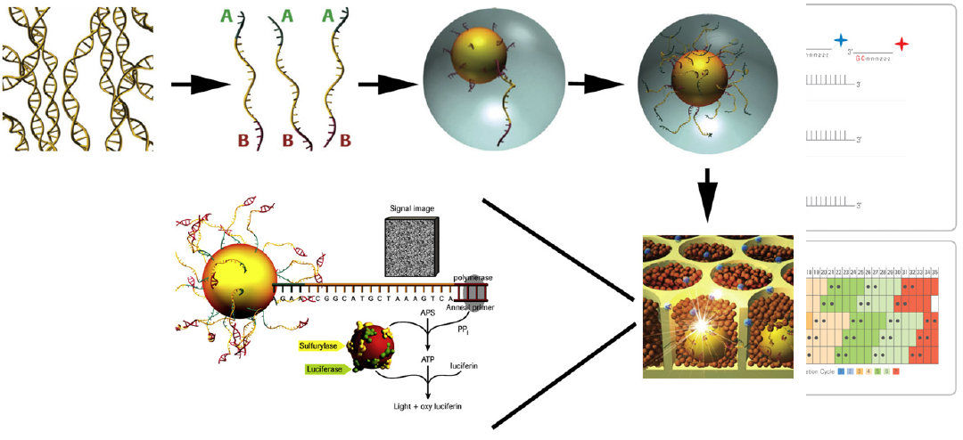

Slide 6
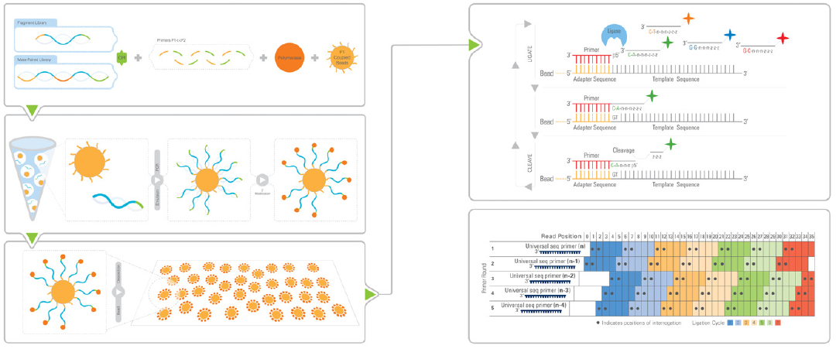

Slide 7
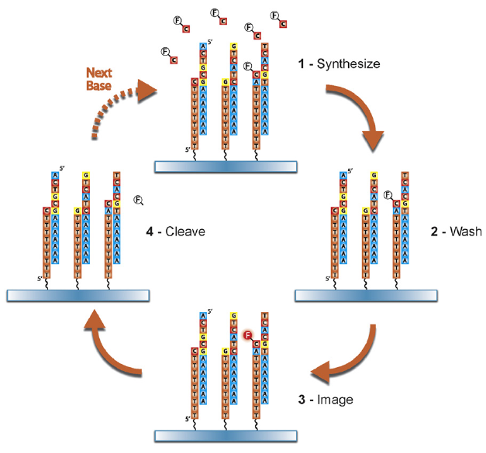

Slide 8
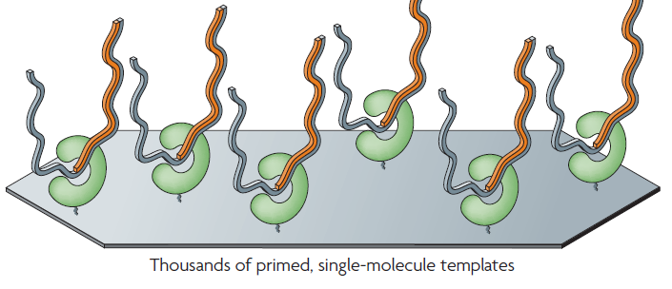

Slide 9
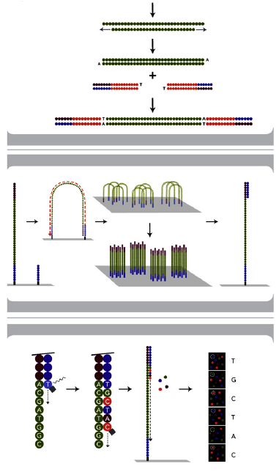

Slide 10
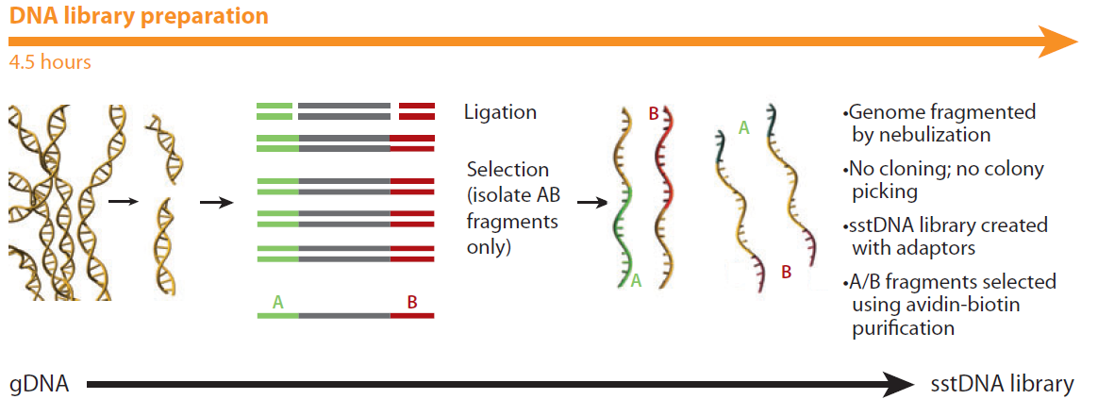
454

Slide 11
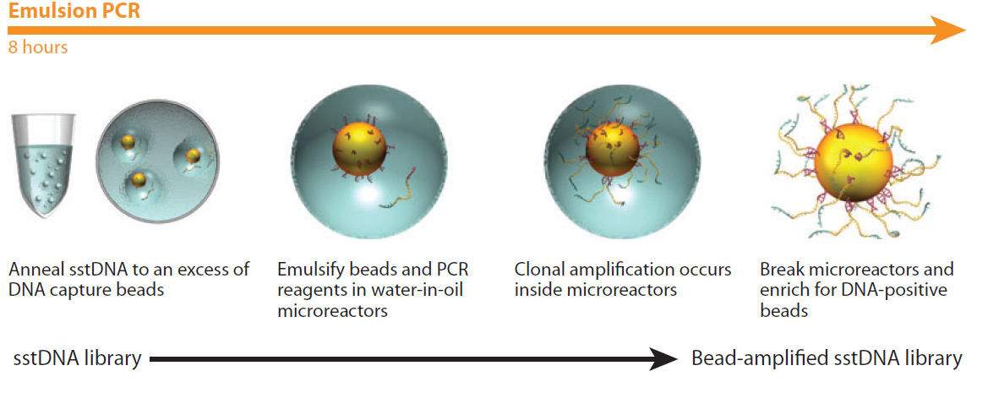

Slide 12
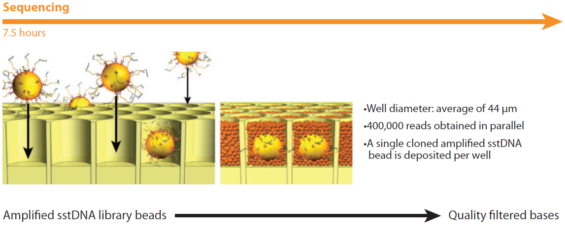

Slide 13
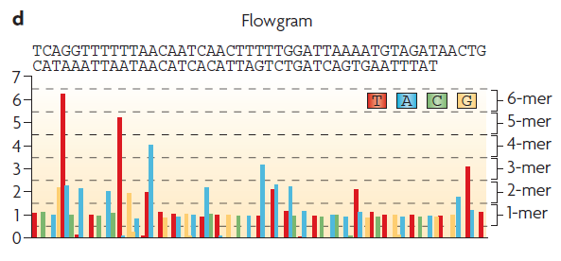

Slide 14
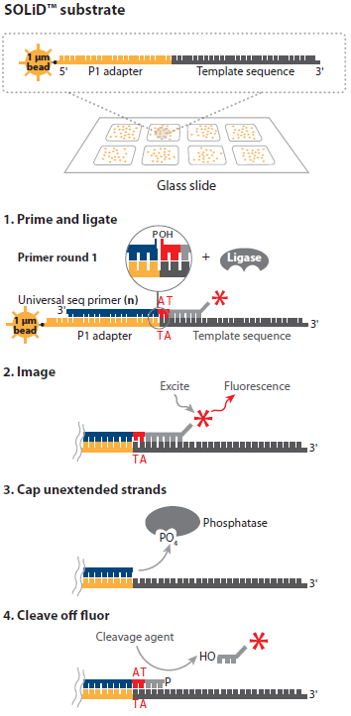
SOLiD

Slide 15
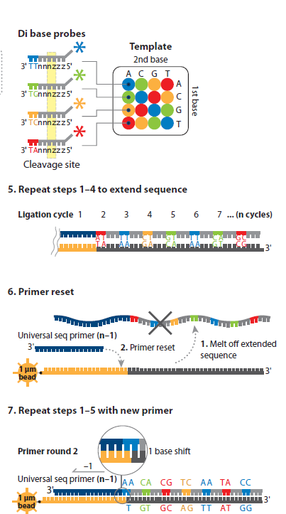

Slide 16
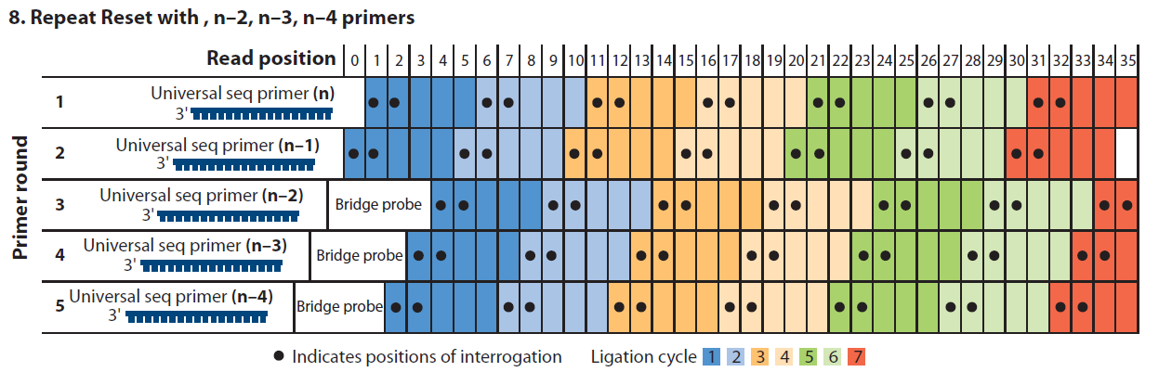

Slide 17
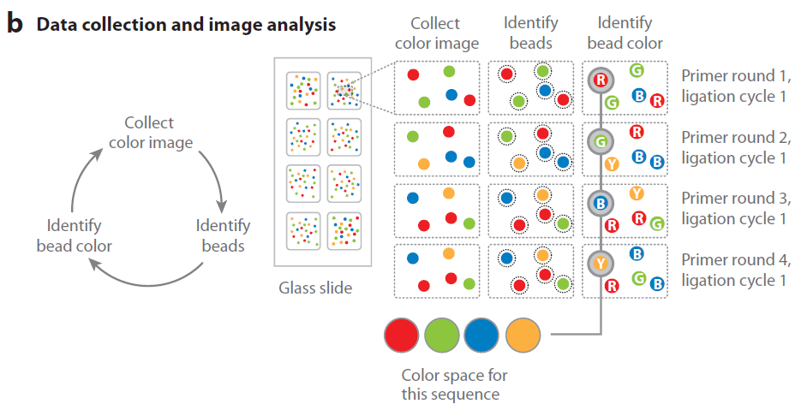

Slide 18
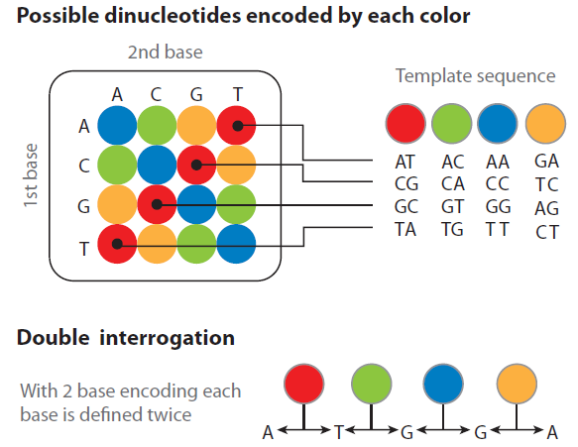

Slide 19
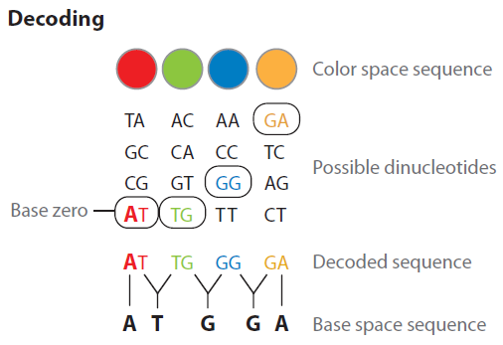

Slide 20
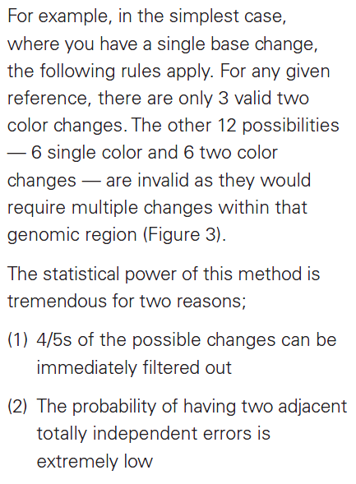

Slide 21
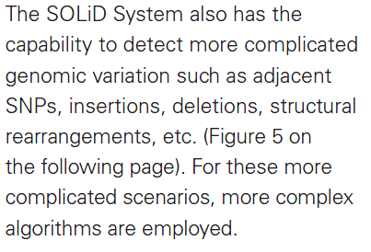

Slide 22
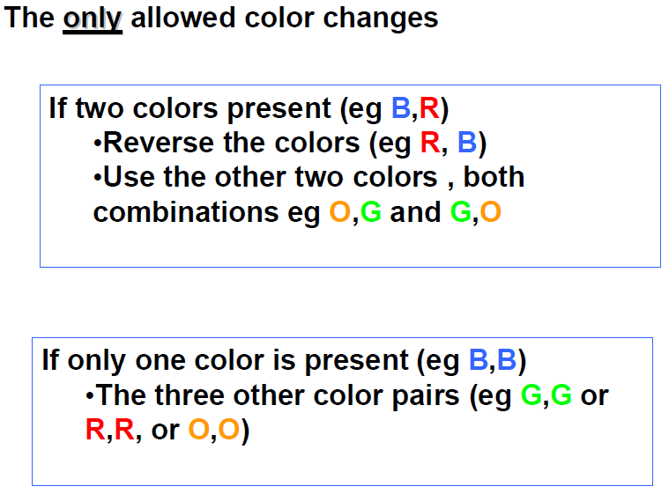

Slide 23
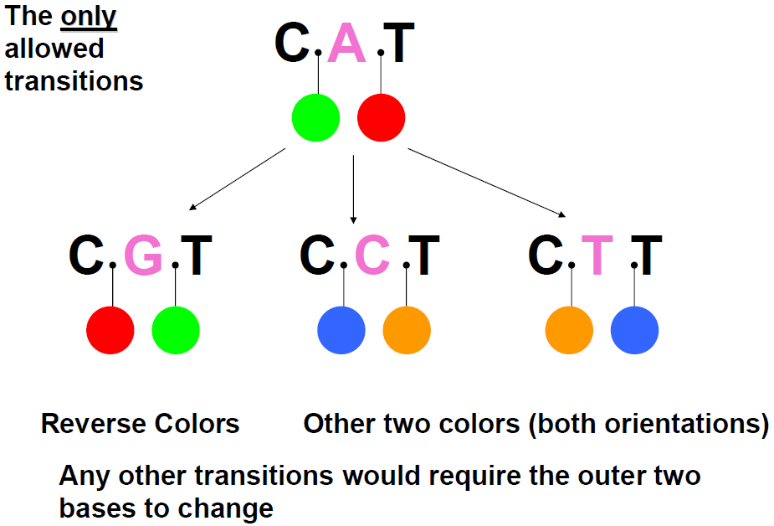

Slide 24
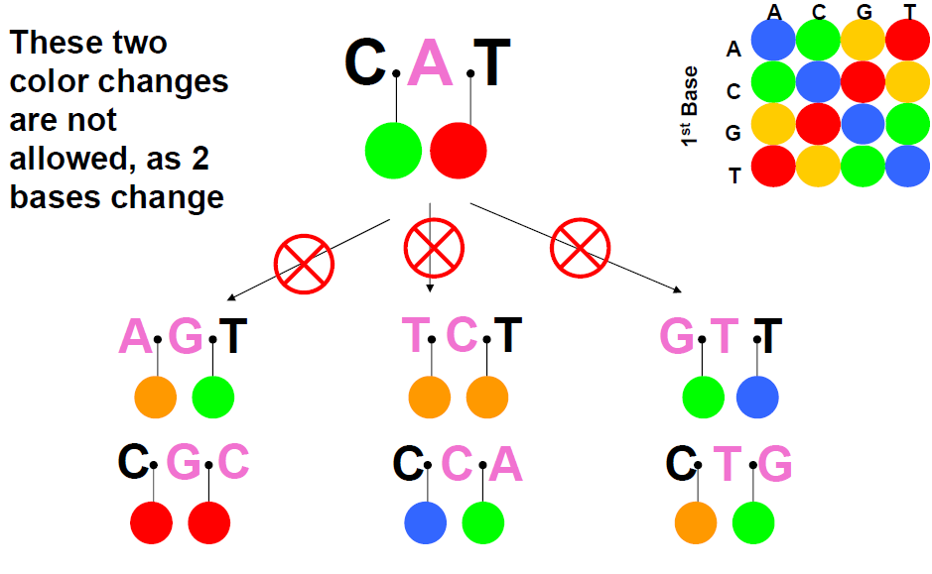

Slide 25
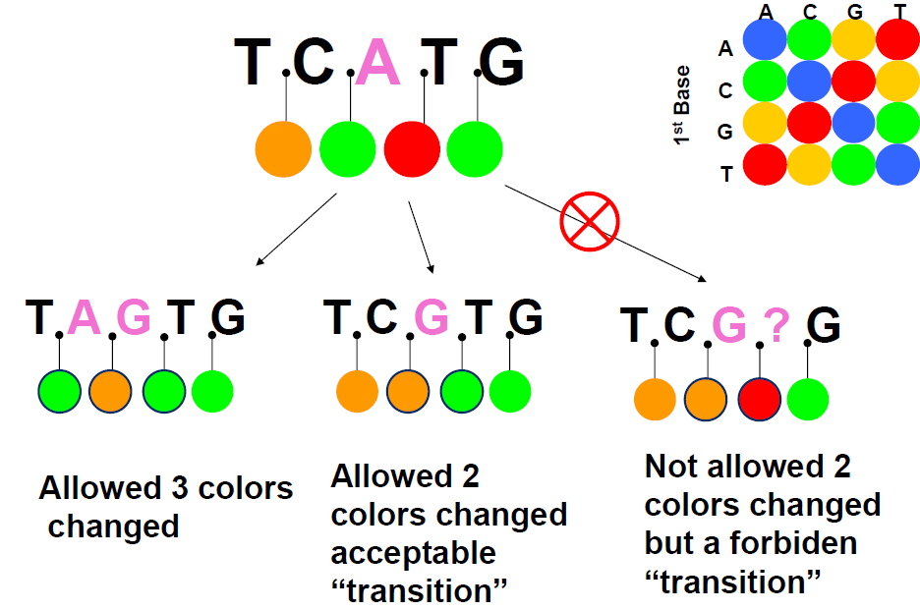

Slide 26
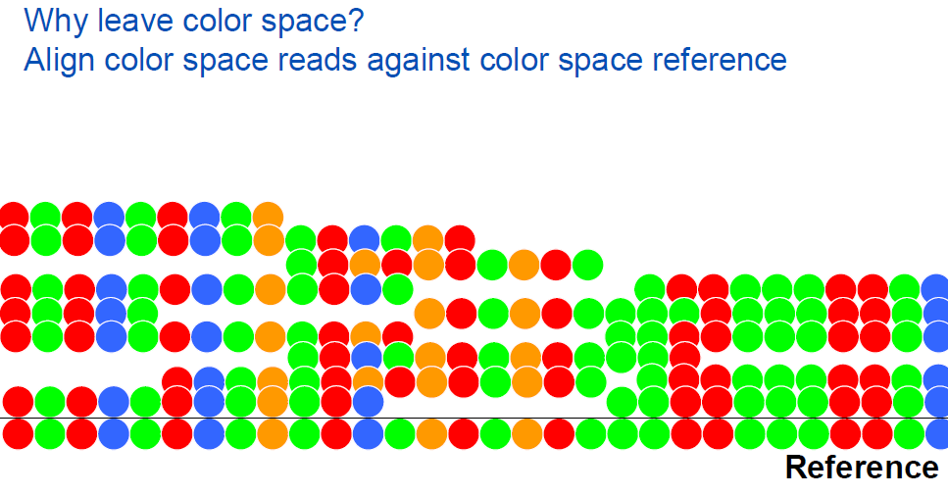

Slide 27
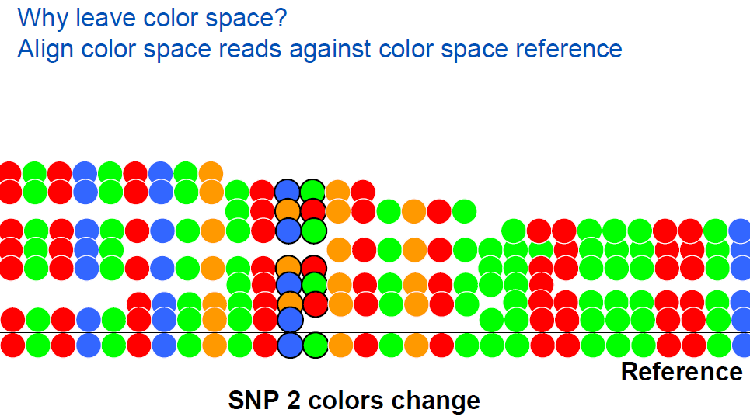

Slide 28
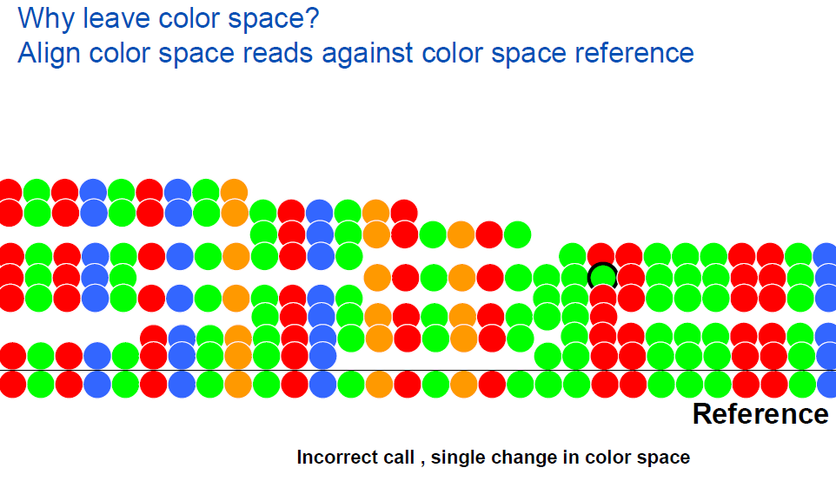

Slide 29
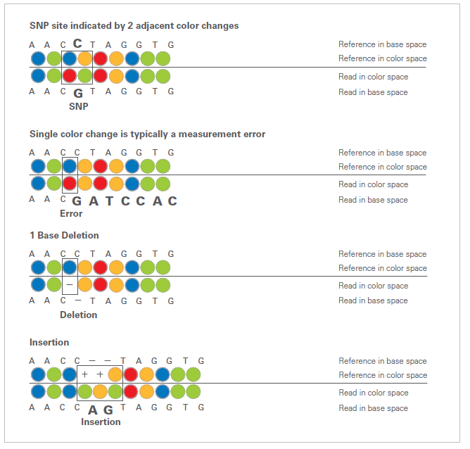

Slide 30
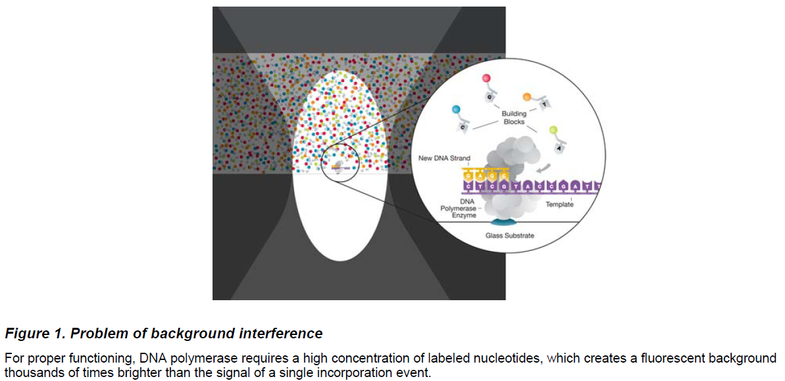
Pacific Biosciences

Slide 31
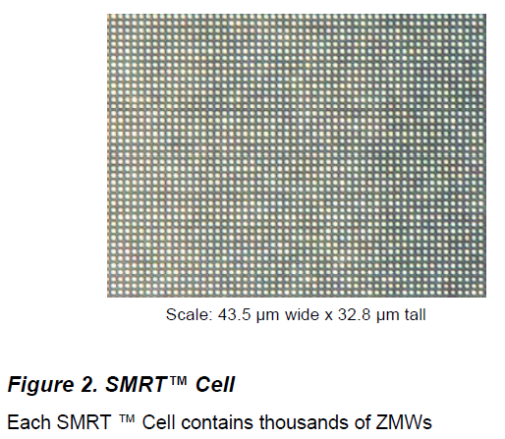

Slide 32
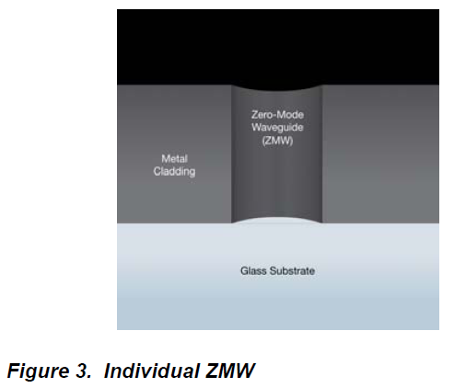

Slide 33
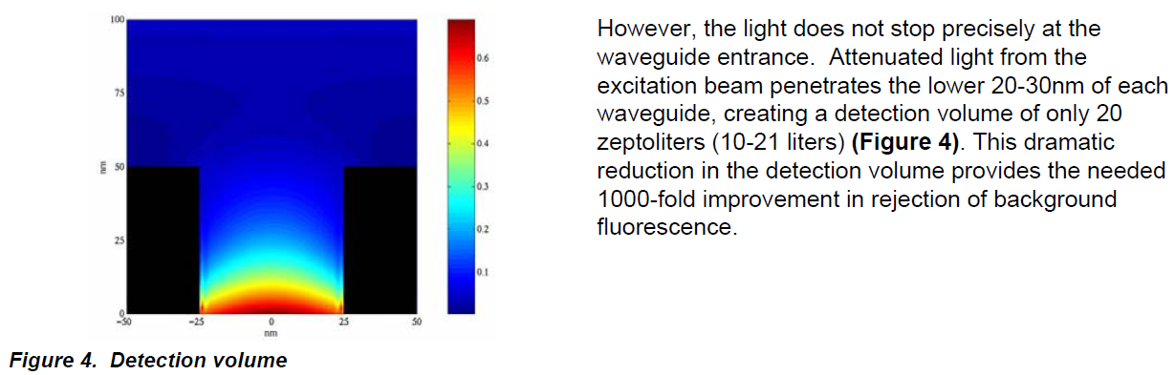

Slide 34
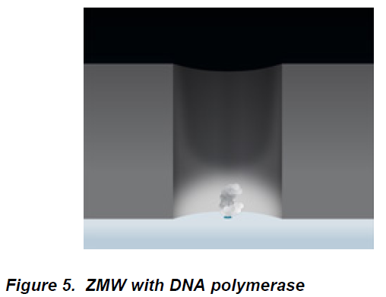

Slide 35
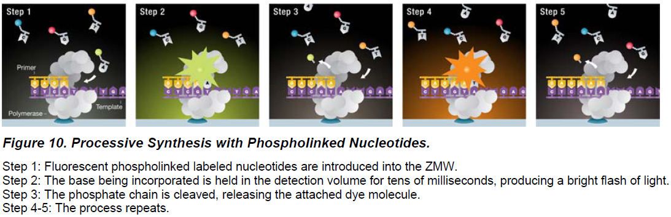

Slide 36
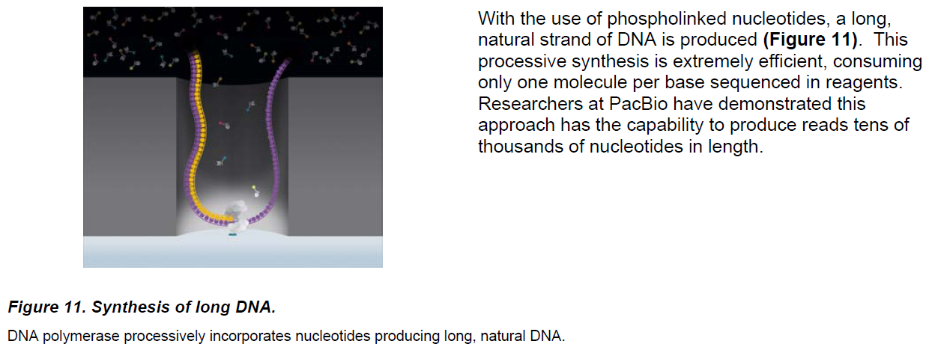

Slide 37
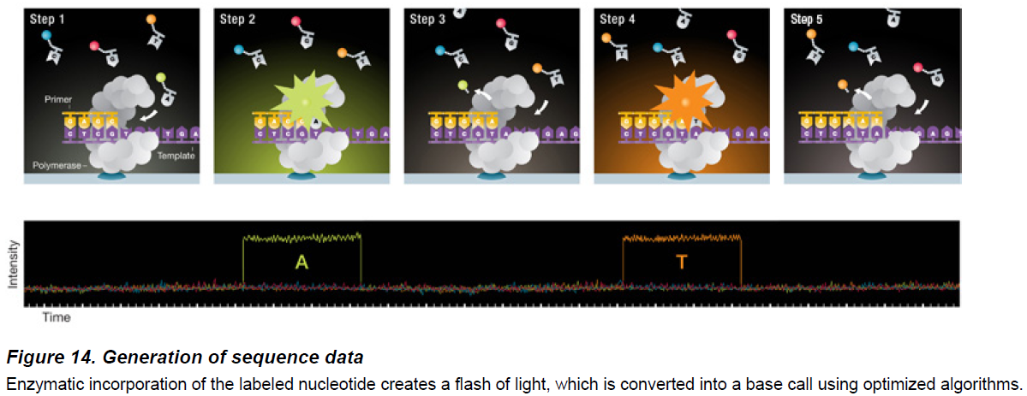

Slide 38
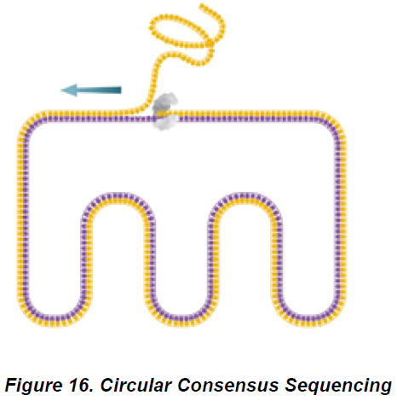

Slide 39
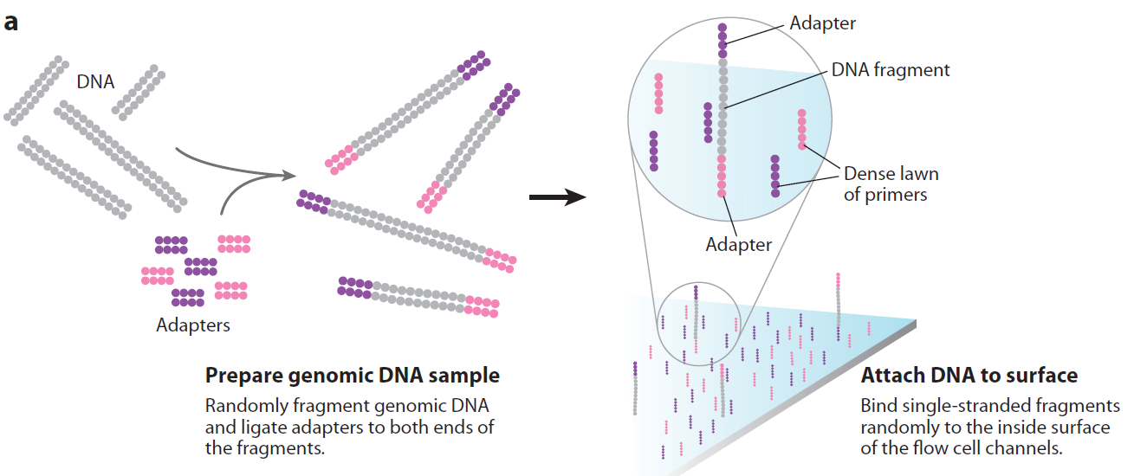
Illumina

Slide 40
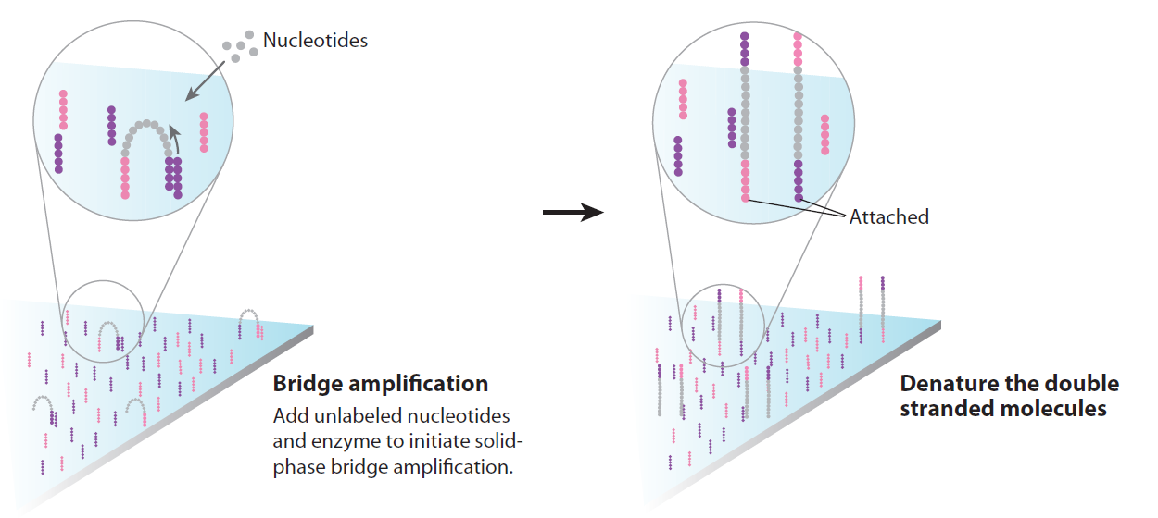

Slide 41
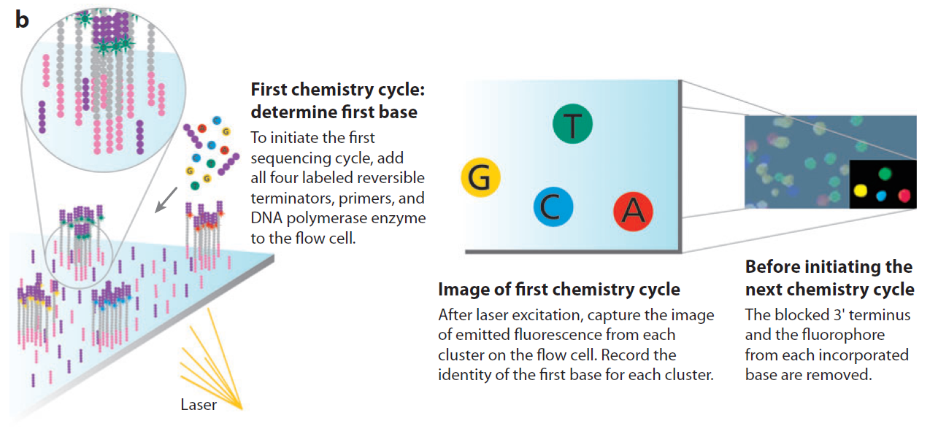

Slide 42
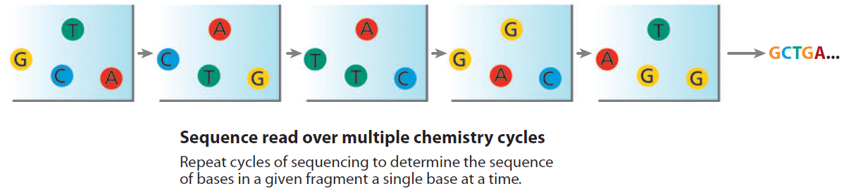

Slide 43
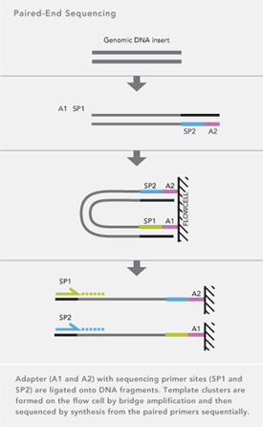
PE and MP

Slide 44
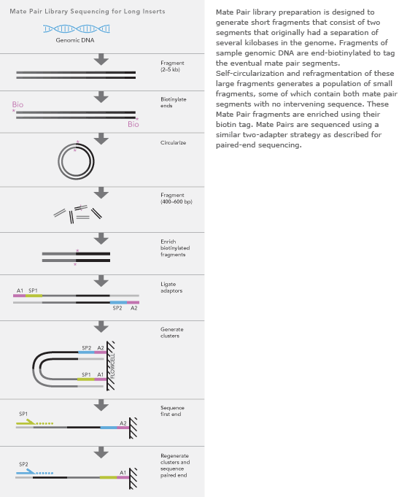

Slide 45
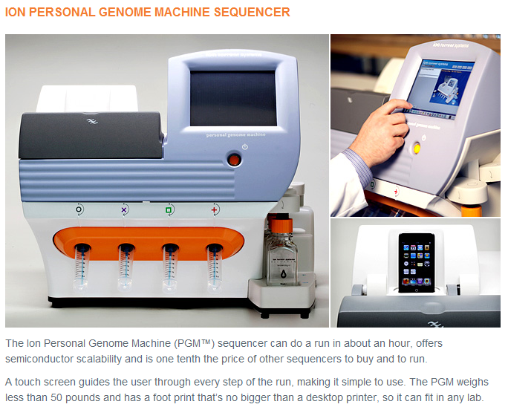
Ion Torrent

Slide 46
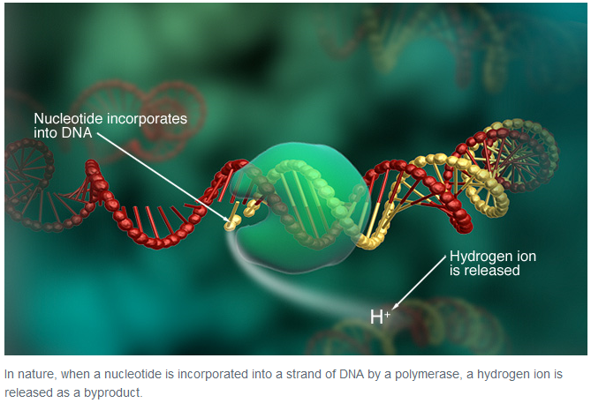

Slide 47
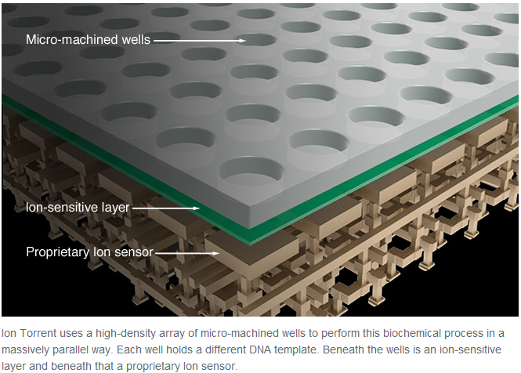

Slide 48
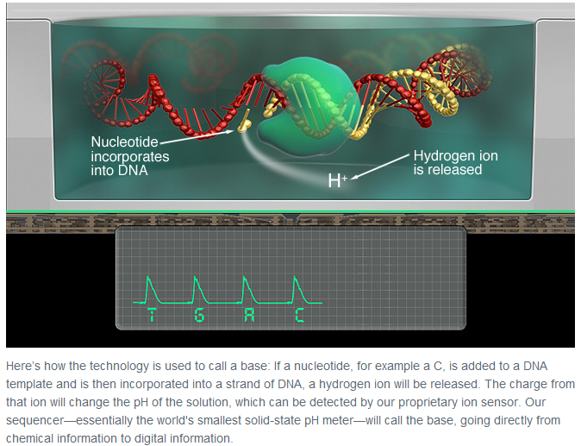

Slide 49
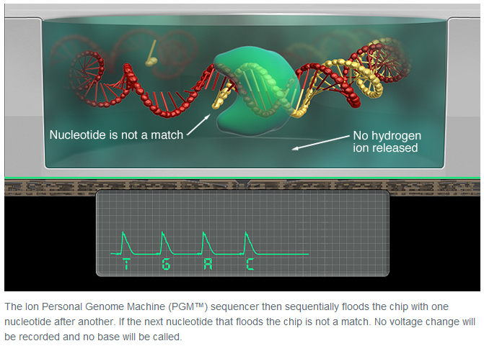

Slide 50
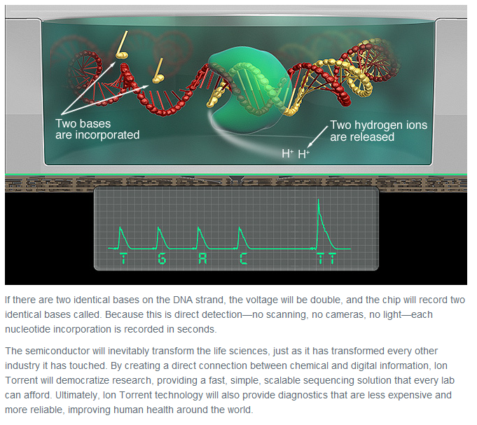

Slide 51
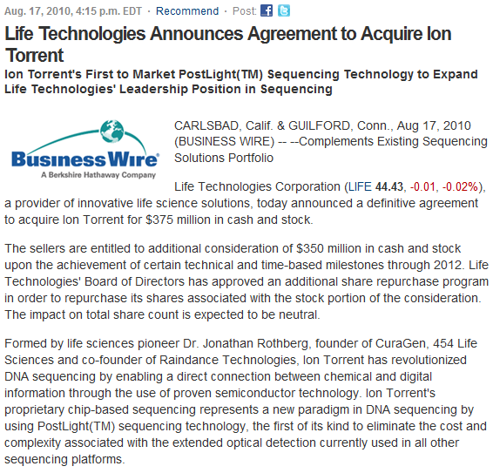

Slide 52
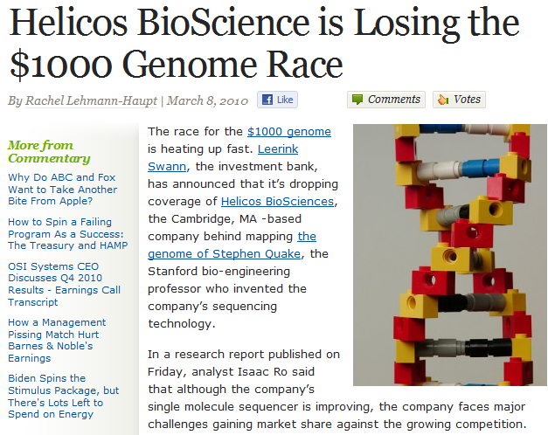

Slide 53
NGS tech

Slide 54


Slide 55
References
1. Mardis, E.R. Next-generation DNA sequencing methods. Annu Rev Genomics Hum Genet 9, 387-402 (2008).
2. Metzker, M.L. Sequencing technologies [mdash] the next generation. Nat Rev Genet 11, 31-46 (2010).
3. Tucker, T., Marra, M. & Friedman, J.M. Massively parallel sequencing: the next big thing in genetic medicine. Am. J. Hum. Genet 85, 142-154 (2009).
4. http://seqanswers.com/forums/index.php
5. http://www.iontorrent.com/
6. http://seqanswers.com/forums/showthread.php?t=6447
7. http://seqanswers.com/forums/showthread.php?t=5250
8. http://pathogenomics.bham.ac.uk/hts/

